Slide 1
SMA & HULL TACTICAL Week 9

Slide 2
Today’s Outline
Adding Futures factors into our analysis
Factors selection
Model selection
Developing Strategy
Notes:
Main point of this week: feature filtering

Slide 3
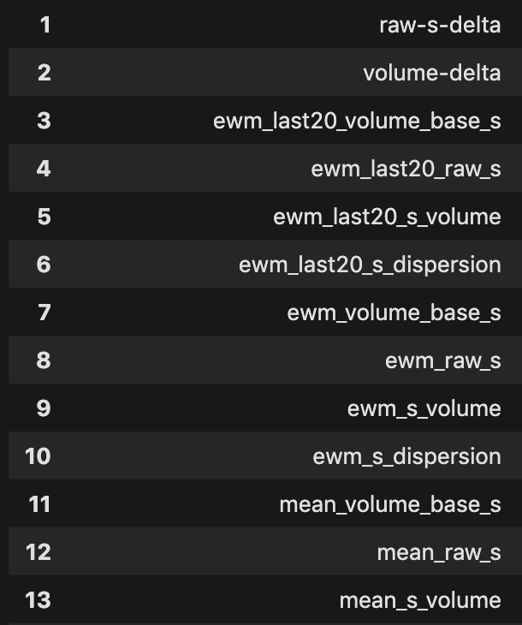
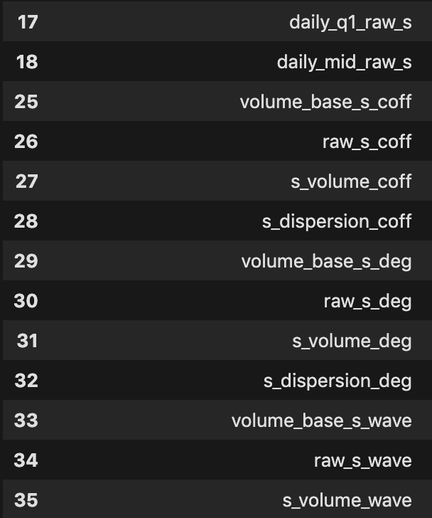
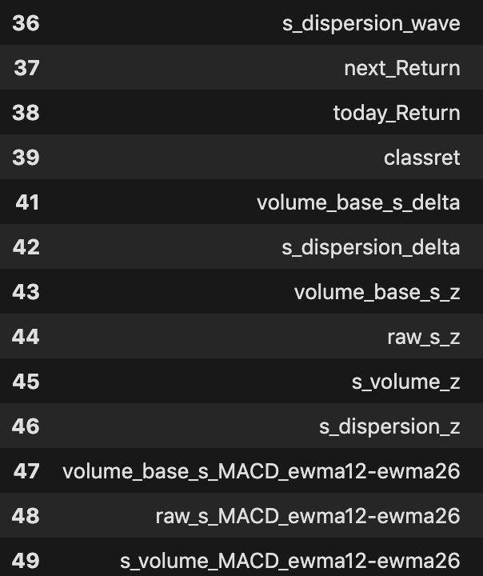
Futures Factors
Recall: 39 factors about future are stationary out of 50 factors we developed.

Slide 4
Factors Selection
 | Selected Factors
Scenario 1 | Set of volume base S
Scenario 2 | Lasso
Scenario 3 | Ridge
select factors out of 102 factors in total

Slide 5
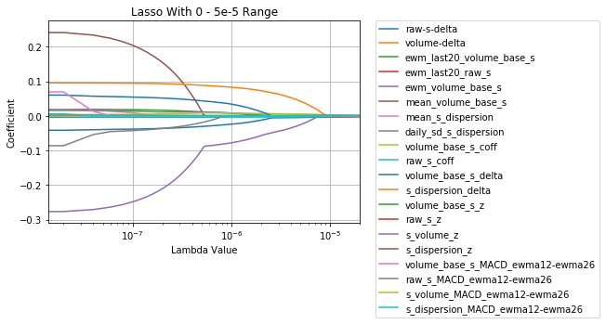
Week 6 Refresher: Lasso Regression
Lasso
Last 5 decayed to 0:
volume_base_s_z
raw_s_z
s_dispersion_z
raw_s_coff
ewm_last20_raw_s

Slide 6
Factors Selection
 | Selected Factors
Scenario 1 | Set of volume base S
Scenario 2 | Lasso
Scenario 3 | Ridge
select factors out of 102 factors in total

Slide 7
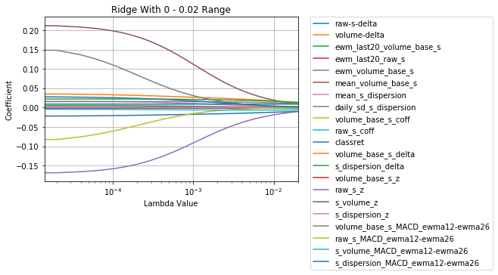
Week 6 Refresher: Ridge Regression
Ridge
Last 5 decayed below 1e-5:
raw_s_MACD
s_dispersion_delta
volume_base_s_delta
ewm_volume_base_s
mean_volume_base_s

Slide 8
Futures: Models
Train Size | Test Size
﻿464 | ﻿134
Used the same data processing method as in SPY data.
Used new evaluation function.
 | Random Forest | Elastic-net Regression
Parameter tuned | Best leaf nodes:2 | Alpha:0.001496
 | Estimator:51 | L1-Ratio:0.1111
Explained Variance | ﻿ 0.000 | ﻿ 0.019
R-square | 0.000 | 0.001

Slide 9
Model: Random Forest

Slide 10
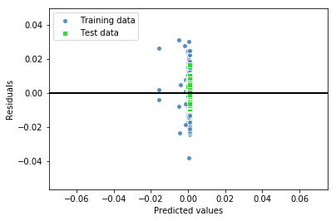
Model: Random Forest

Slide 11
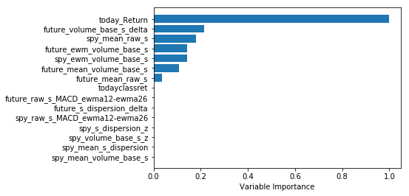
Model: Random Forest

Slide 12
Model: Random Forest
 | Random Forest Regressor | SPY
Sharpe Ratio | 3.26 | 3.01
Return | 10097.64 | 9827.01
Max loss | 813.66 | 986.40

Slide 13


Strategy #1:Illustration
Prediction of returns
Return is positive: buy as much as possible.
$$position=+\frac{Monye in hand}{Current Price}$$
Return is negative: short the same amount as we can buy it.
$$position=−\frac{Monye in hand}{Current Price}$$

Slide 14
Strategy #2:Illustration
Prediction of returns
Return is highly positive: buy as much as possible.
Return is slightly positive: buy …..
Return is slightly negative: short…
Return is highly negative: short…

Slide 15
Decision: Random Forest

Slide 16
Decision: Random Forest Classifier
 | Random Forest
Parameter tuned | Best leaf nodes:3
 | Estimator:161
Accuracy | 0.403
R-square | -0.480

Slide 17
Model: Random Forest

Slide 18
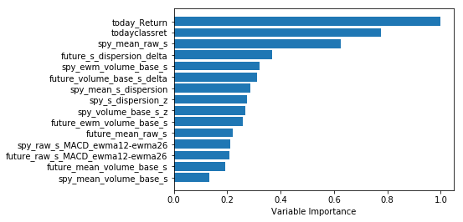
Model: Random Forest

Slide 19
Model: Random Forest
 | Random Forest Regressor | SPY
Sharpe Ratio | 3.33 | 3.01
Return | 14080.31 | ﻿ 9827.01
Max loss | 45.21 | 986.40

Slide 20
Decision: Random Forest

Slide 21
Model: ElasticNet

Slide 22
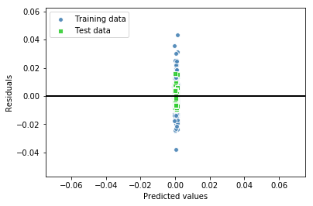
Model: ElasticNet

Slide 23
Model: ElasticNet
 | ElasticNet | SPY
Sharpe Ratio | 3.05 | 3.01
Return | 10090.13 | ﻿ 9827.01
Max loss | 783.75 | 986.40

Slide 24
Decision: ElasticNet

Slide 25
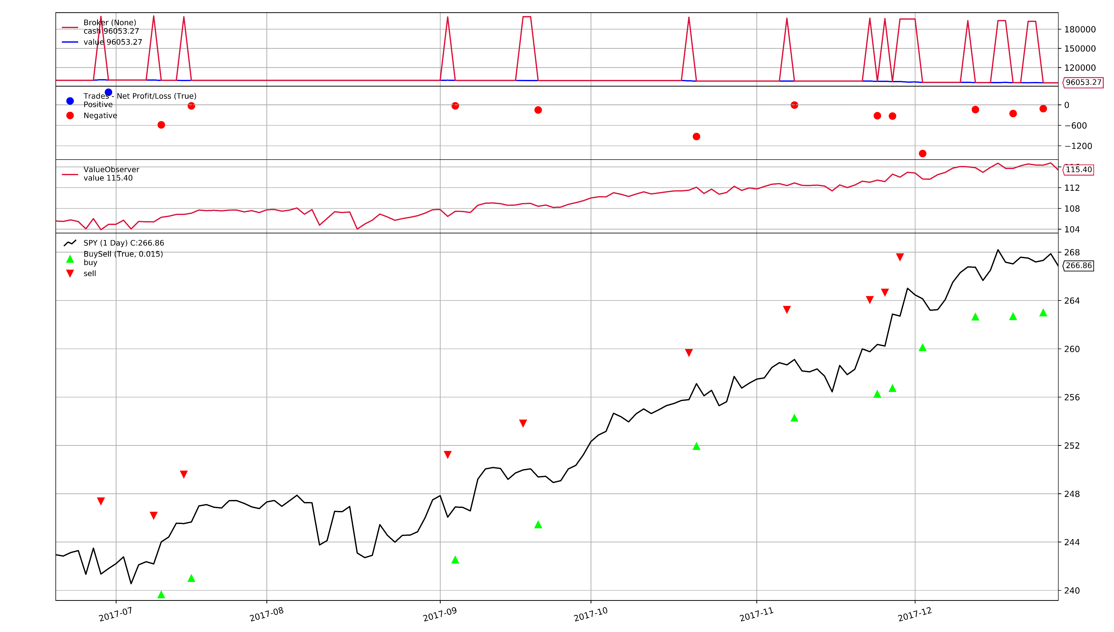
Back Test with backtrader

Slide 26
Conclusion

Slide 27
Thank you!
Notes:
PCA is orthorgonal transformation of each factor

